Slide 1

Time Series Forecasting Platform
(Brent Crude Oil)
Akil Mohamed Firos
Student id - 219015127
MSc AI for Business Intelligence
Academic Supervisor - Andrew Morozov
Sprint 3.1 - Initial Platform Building

Slide 2
Table of Contents
Sprint 3.1 Key Accomplishments
System Architecture & Data Pipeline changes
Core Dashboard Modules
Planned Enhancements

Slide 3
Sprint 3.1 Key Accomplishments
Transitioned offline Jupyter notebook experiments to a modular backend (src/data_loader.py & src/models_engine.py).
Built live market indicator cards (Brent Spot, WTI, DXY Index, VIX Volatility).
Implemented an interactive multi-model forecast visualizer with Plotly.
Integrated a live model evaluation matrix ($MAE, RMSE, R^2, MAPE$).
Embedded a historical dataset explorer & summary statistics inspector.

Slide 4
System Architecture & Data Pipeline changes
Data Loader (data_loader.py): Raw dataset ingestion, log transformations (Brent_Log), and automated feature engineering (lags 1–3, DXY/VIX/OPEC Z-score normalization).
The notebook dir will now be used as the testing environment for new models to be built before deploying it onto the dashboard.
Models Engine (models_engine.py): Unified execution across all models using a 80/20 chronological split (maintaining temporal order).
Streamlit App (app.py): Fast frontend rendering with @st.cache_data caching.

Slide 5
Core Dashboard Modules
Market KPI Metrics Bar: Live tracking of crude spot prices & daily price deltas.
Plotly Forecast Visualizer: Interactive line chart with hover crosshairs, zooming, and toggleable model traces.
Model Performance Matrix: Side-by-side comparative table ($MAE, RMSE, R^2, MAPE$).
Historical Data Inspector: Expandable dataset viewer & summary metrics (describe()).

Slide 6
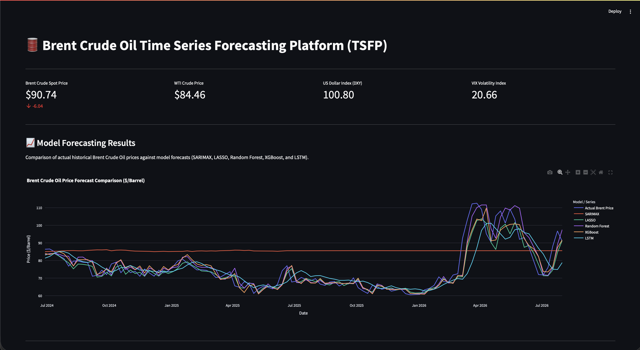

Slide 7
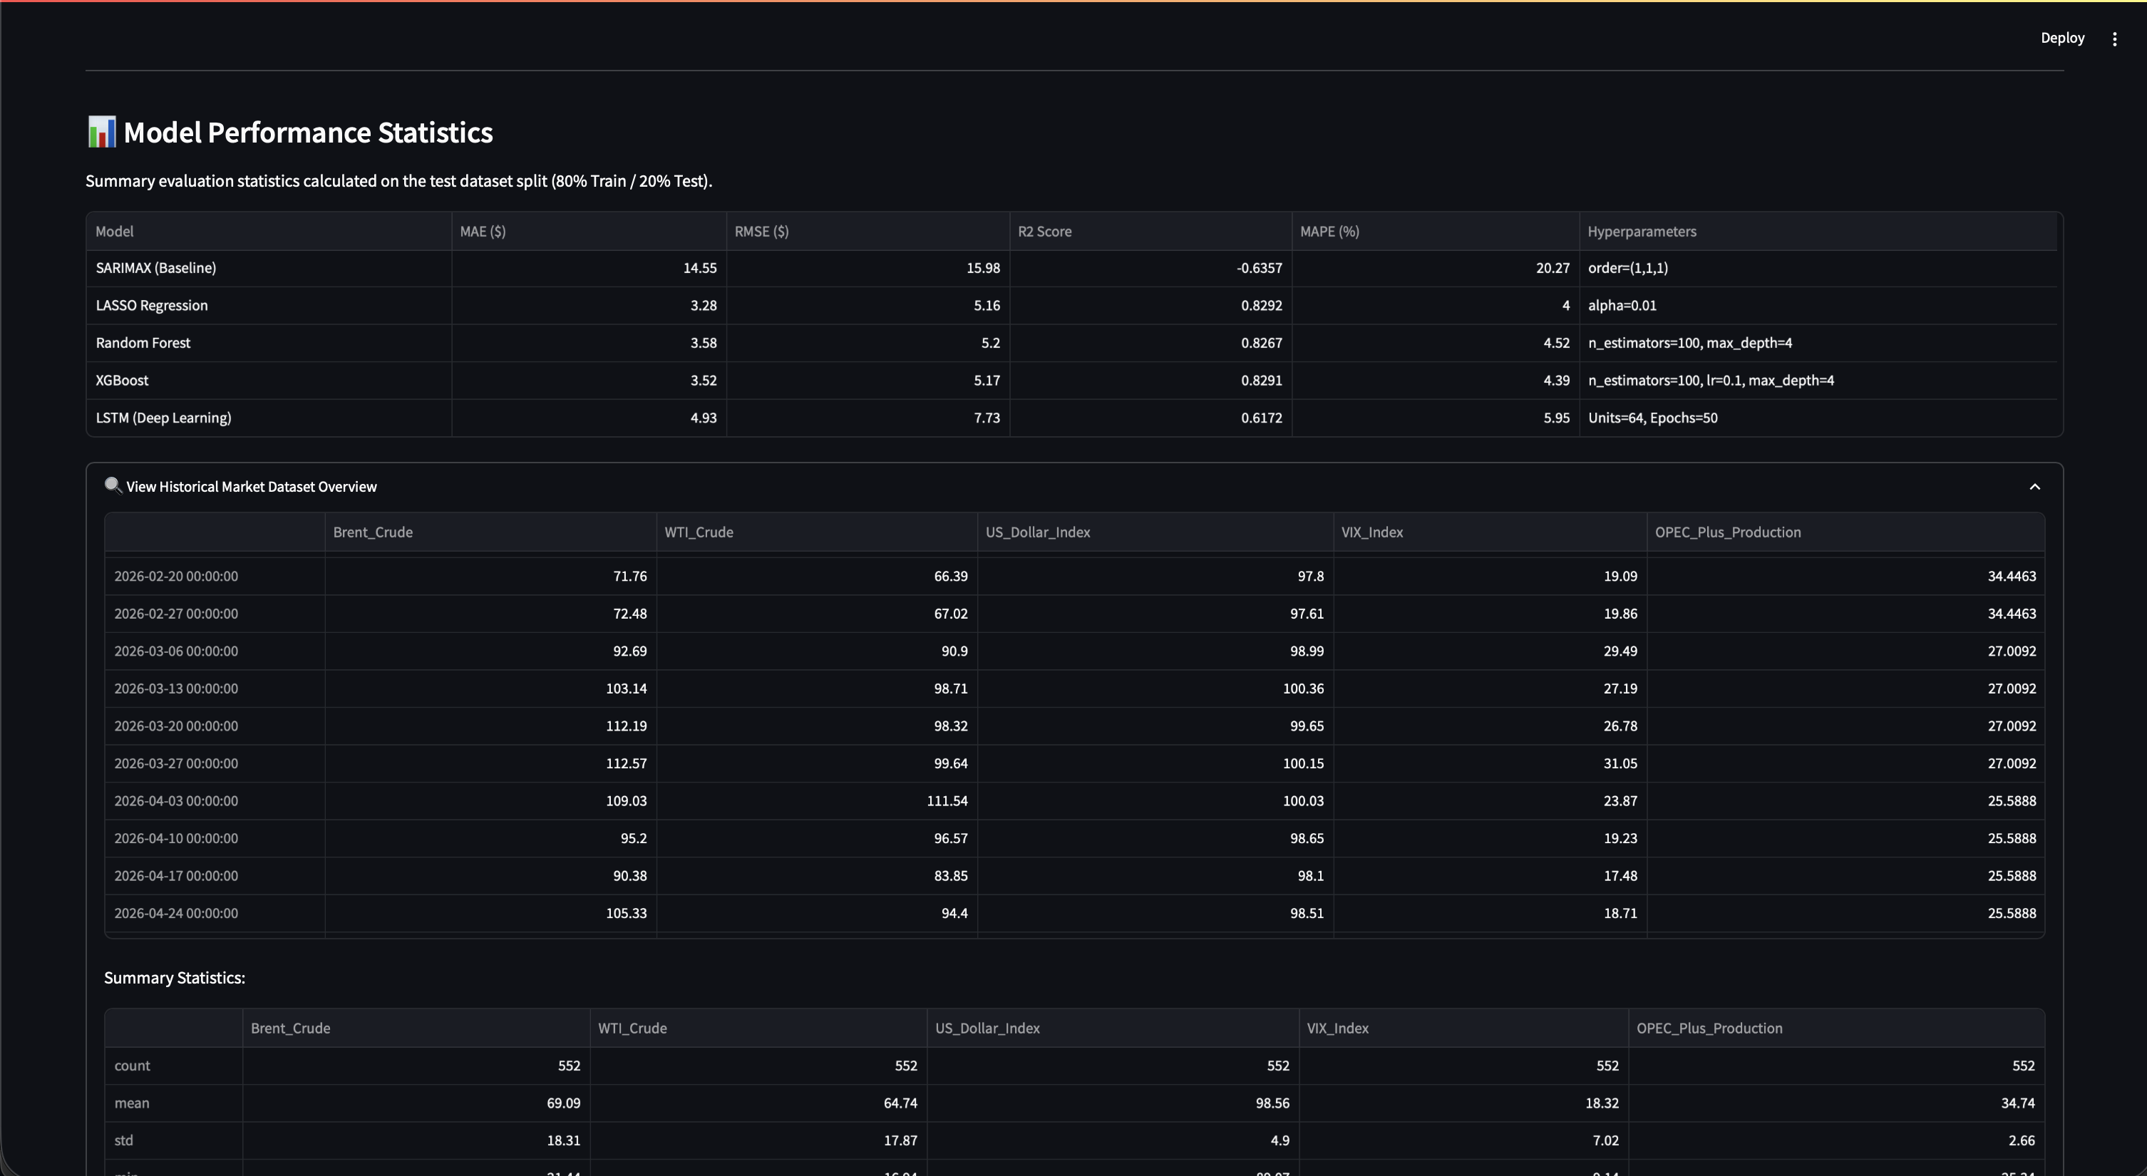

Slide 8
Planned Enhancements
Custom CSV Upload: Interactive upload feature for custom market datasets.
Dynamic Model Hyperparameter Tuning: Sidebar controls to adjust parameters on-the-fly.
Automated Data Fetching: Live API integration for real-time market data ingestion.
Adding Risk Metric / Risk-Adjusted Decision Indicator
Need to answer to the needs of two kinds of audience :
  You have the professional audience where for them they will go in-depth into the data asking the question why should I buy at this price, or why should I sell now ,all the advanced thinking ? So, a visualization appropriate to them is needed.
  You have the unprofessional audience where to them they don’t know much about the info I am giving them and just want a quick overview of what to do. Like what is the condition right now and should I buy or sell, if I buy now how much PnL would I make over a certain period, etc.
The chart needs to be more interactive, meaning say for the model chart on the side you could have a drop-down list containing the years and for that selected year you can show the results for that particular year and when you reset it shows chart till current date.

